Slide 1

Microsoft Secure
Kris Swanson
Partner Technology Strategist

Slide 2

The digital estate
Smart cities
Sensors
Vehicles
Energy systems
Cloud
Partners
Citizens
Marketplaces
Equipment
Customers
Mobile devices
On-premises
Supply chains
Manufacturers
Notes:
Ever increasing
Protect data behind firewall and in the cloud
- When data moves to the cloud, traditional perimeter based security no longer effective

Slide 3
Simplicity
Notes:
Complexity is the enemy of security

Slide 4
The market is fragmented and confusing
Data & application security
Fraud prevention
Infrastructure security
Anomaly detection
Hybrid cloud security
Market
Endpoint protection
Threat management
Security management
Data loss prevention
Cloud Access Security Broker
Identity & access management
Data center security
150+ security controls
500+ vendors
Information rights management
Compliance tools
Threat detection
IoT security
Email security
Notes:
MS trying to simplify. We know you deal with complex and sophisticated organizations and technologies.
We see elegance from simplicity, and that flows down to the end user experience.
One of the big challenges in security is that the market is very fragmented and very confusing. There are dozens and dozens of categories of solutions, and within each of those categories there are dozens or maybe even hundreds of solutions to choose from. If you went to a major security conference right now you would find over 150 different types of security controls represented—everything from antivirus for endpoints to anti-drone technologies, from 500 or more vendors. And that would just be at one conference. Many of our customers are struggling just to figure out: how many of those solutions do we need in place?

Slide 5
Challenges to defense
Identity-based attacks are up 300% this year
Information is your most attractive target
96% of malware is automated polymorphic
Most enterprises report using more than 60 security solutions
Notes:
First, identity-based attacks are up 300% this year.
This is because identity is the key to securing any one of those elements of the digital estate diagram we looked at earlier. You need to understand the identity of the person who is trying to access the information or the application or the device. In some ways, this is the last bastion of control for many IT organizations. It’s becoming the essential control plane for security. Attackers understand that, and so they are focused heavily on stealing and cracking passwords. Once they have a valid username and password, they can work their way toward their ultimate target: information
Information is, after all, your most attractive target. We're no longer protecting against hackers or script kiddies who launch attacks for fun or notoriety. The attackers you're protecting against are trying to steal something from you for monetary gain, and information is most likely that something. Making matters worse, one implication of the new digital estate is that information is going to move into and out of systems that IT controls. It's going to move out of those systems onto mobile devices. It's going to get emailed to people outside the organization. It's going to go to partners and customers. And so the size of this target is actually growing.
The third trend is, broadly stated, that attackers are now heavily using automation tools and other sophisticated methods to help their attacks spread incredibly quickly. That makes it very difficult for a human or even a team of human people to keep up. We're seeing that 96% of the malware we detect is automated polymorphic. That means it changes its look and shape every time it infects a new system. This is a means of escaping traditional types of detection. And it’s just one example of how attackers are using automation to move quickly
Lastly, many security operations center analysts are finding themselves completely swamped—because they're using more than 60 security solutions on average, and those solutions aren’t integrated with each other. This is also where many of our customers tell us they are experiencing talent shortages today. They're finding it difficult to hire good quality security operations center analysts to conduct investigations and decide how to best remediate.

Slide 6
Challenges to defense
Strategies for success
Identity-based attacks are up 300% this year
Adopt identity-based protection
Information is your most attractive target
Protect information wherever it goes
96% of malware is automated polymorphic
Detect attacks faster and automate response
Most enterprises report using more than 60 security solutions
Use tools that integrate investigation experience and provide guidance
Notes:
The number one we would recommend for every organization is to adopt identity based protection. This is an absolutely critical starting point for a strong defense against today’s attacks.
The second strategy is that you should protect information wherever it goes. As documents and emails move around inside and outside your organization, the protection has to go with it.
The third strategy is to detect attacks faster and automate your response. As attackers adopt automation, you need to also have automation in your corner. Protection, or prevention, is still every bit as important as ever. But even the best protections can be beaten, and so you need to be able to quickly detect attacks and then automate the response.
And the last strategy here is that you should use tools that integrate the investigation experience for your IT team and provide guidance for them. Their time is an increasingly precious resource, and you need to make the most of it. This is why it’s important to use tools that integrate the investigation experience across all of the surfaces that an attack has touched, from the end point, the desktop or mobile device, to the identity that was used for that attack, to the other server systems that may have been impacted and so on. Being able to look across all of those surfaces and understand that attack across all of those different surfaces is really important to efficiently dealing with an issue. Having guidance is also very important because the techniques for defending change daily, and it's very difficult for IT personnel to keep up with how they should defend against the latest types of attacks.
These are the four strategies we think are useful to help focus your energies and your security investments. They also are the way that we focus our research and development investments at Microsoft.

Slide 7

Our commitment to you
Security
Privacy & control
Compliance
Transparency
Reliability
Notes:
At Microsoft, as we operate all of our cloud services for our customers, we really think about our responsibility as being even broader than that. It includes privacy, control, making sure that you have control over your data and that you know what's happening with it. Transparency, that you can achieve the compliance objectives that you need to, and that you have the reliability that you count on for cloud services.
But I want to focus today on just security, and in particular how you can approach this challenge for your evolving digital estate.

Slide 8
Our unique approach
Intelligence
Platform
Partners
Notes:
We spend about $1 billion dollars every year on that research and development
how can we at Microsoft do something that's unique that the other parts of the ecosystem are not able to provide? What is the additional capability that we can layer on top of what our partners have already done? That shows up in three areas: intelligence, platform and partners.

Slide 9

Microsoft Intelligent Security Graph Unique insights, informed by trillions of signals
Shared threat data from partners, researchers, and law enforcement worldwide
OneDrive
930M threats detected on devices every month
Outlook
400B emails analyzed
1.2B devices scanned each month
200+ global cloud consumer and commercial services
Botnet data from Microsoft Digital Crimes Unit
Windows
Enterprise security for 90% of Fortune 500
Azure
Microsoft accounts
18B+ Bing web pages scanned
Bing
450B monthly authentications
750M+ Azure user accounts
Xbox Live
Notes:
The center piece of our investment in intelligence is the Microsoft Intelligent Security Graph. This is how we describe the way that we synthesize a vast amount of data from a huge variety of sources.
450 billion authentications with Azure Active Directory every month
400 billion emails get analyzed by our Outlook.com and Office 365 email services every month
1.2 billion devices get scanned every month by Windows Defender
We operate 200-plus global cloud, consumer, and commercial services. Everything from outlook.com to Xbox Live to Office 365 to Azure, and so on. And with all of those services, we have a tremendous amount of surface area that we defend.
Bing scans about 18 billion web pages every month, giving us really great insight into what people are doing with web scripting technologies when it comes to attacks and phishing campaigns. And we have a great way to look at that and understand how we should help customers defend based on that information.
On top of all of that we layer shared threat data that we get from our partners, from the researchers here at Microsoft who are part of our 3,500-plus people that are full time on security, and law enforcement agencies that we partner with worldwide through our digital crimes unit, as well as botnet data that we collect through the digital crimes unit. All of that intelligence makes up the Intelligent Security Graph.
And why is it a graph? It's a graph because what's really important is connecting these pieces of intelligence, so that these signals are not just individual points of information. The graph brings them together as something that we can draw patterns across. We can learn from one point of data to influence how we interpret another point of data.

Slide 10
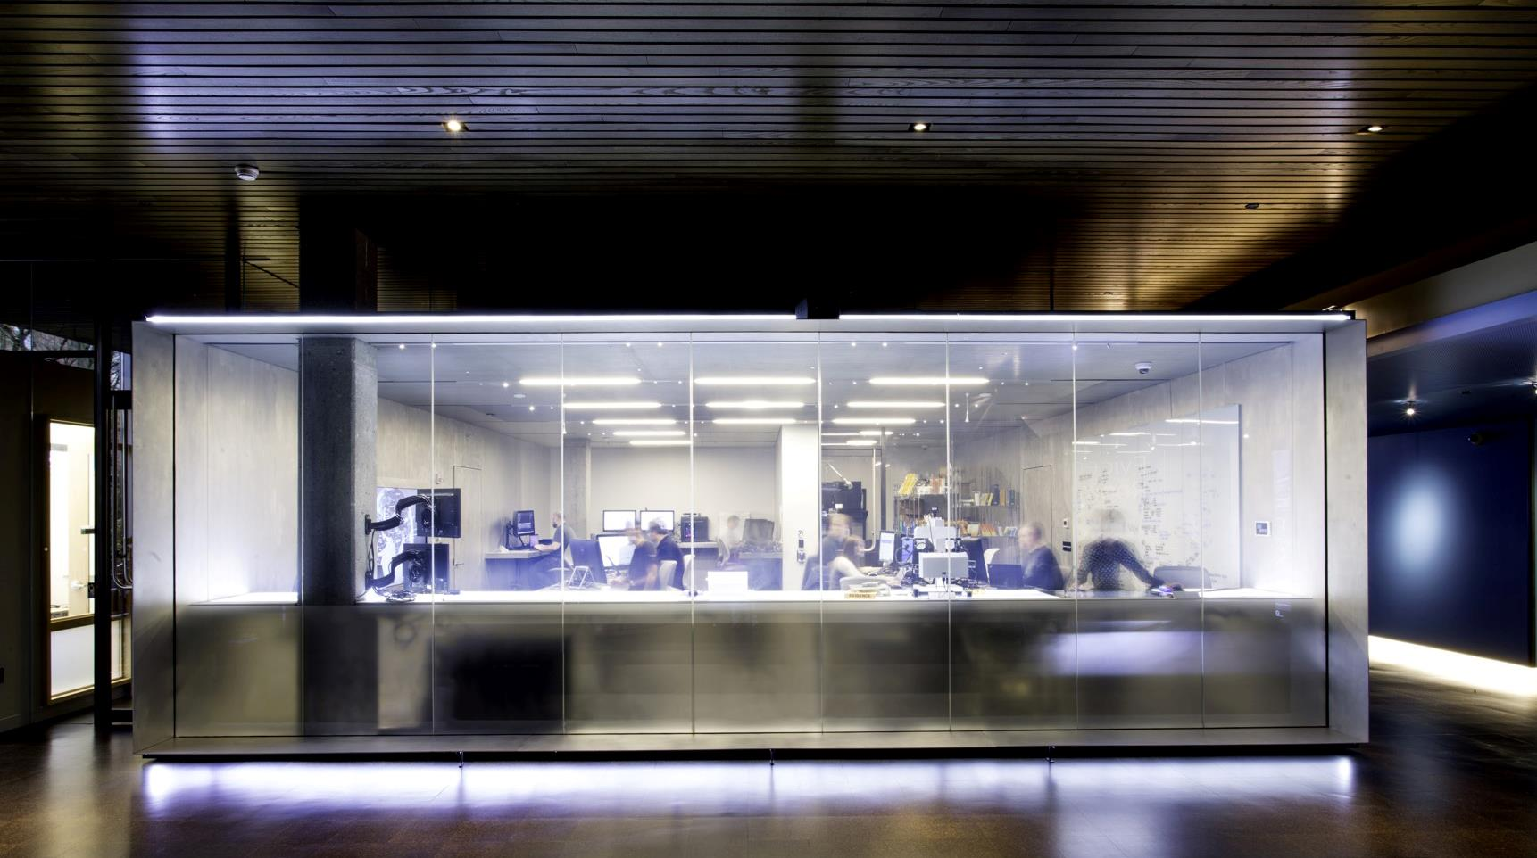

Our intelligence
INTELLIGENCE
Notes:
And it's not just about machine learning and artificial intelligence. Those are important, of course, and they're central to our effort, but it's also about the people, the experts at Microsoft who interpret the data and do the investigative work on incidents that only humans can do.
Those security experts are in what we call the Cyber Defense Operations Center. They defend our services, Azure and Office 365 and so on, on behalf of our customers. They also defend Microsoft's IT infrastructure on behalf of Microsoft, and they are combined in the same building with our Digital Crimes Unit, so that all of that human brain power can work together on tough security problems.
We believe that we have best-in-class operations for security, and we can continue to advance the state of the art by just performing those operations daily. We share that intelligence with our customers both in the form of information about how we do it and how they might structure their own operations, but also in the form of continually improving that Microsoft Intelligent Security Graph.

Slide 11
Our unique approach
Intelligence
Platform
Partners
Notes:
So, that's the intelligence piece of our investments. And that informs everything we do in these other two areas. Now, let's dig into platform.

Slide 12
Physical
security
Perimeter
Building
Server environment
Operational security
Continuous testing
Restricted access
Thousands of security professionals
Secure foundation
Intelligence
Platform
Partners
Customer controls
Access control
Encryption & key management
Network & DDoS protection
Notes:
Platform has two sides of the coin. The first side is the secure foundation of our cloud services. This is about how we operate our own cloud services, Azure, Office 365 and so forth. We have some of the world's best physical security, with fences and barbed wire and so on to provide secured building environments and within those buildings, secure server environments.
To enter a server environment, for example, a person would have to pass through multiple physical layers and provide multiple forms of identification. They would also be scanned for metal in their pockets to make sure that they are not bringing devices in to steal information. So, there's a great deal of physical security in place that we do on behalf of all of our customers in our cloud services and that make it possible for our customers to really leverage the investment that we've made in that respect.
Operational security I touched on a minute ago when we talked about the human piece of the Intelligent Security Graph. One of the ways this comes to life is in our continual testing of our services, making sure that that we're finding vulnerabilities faster than the bad guys can. We have a big focus on red team, blue team exercises. If you're not familiar with those, the idea is that we have dedicated professionals whose job it is to be on the good side but act like the bad guys—they’re constantly trying to find ways to penetrate the services, find ways that hackers might attack us so that we can shore up our defenses.
Another example of our operational excellence is around restricted access. When Microsoft employees need elevated access so that they can do maintenance on a service, or so they can investigate a customer support issue, they only have access to exactly the resources they need to access and for only exactly the amount of time that they need it. So, they have just in time and just enough access to do their work, and then they get out. They don't have any standing elevated access that allows them to view customer data.
And this is something, again, where we can make an investment at Microsoft that gets heavily leveraged because all of our customers benefit.
Lastly, customer controls are a huge important part of this. This is something that we get asked about a lot when we talk to customers about our cloud services. What are the things that I have at my control so that I can decide how I want to manage my data and access to it? Access controls, of course, are the very foundation of it. Multi-factor authentication for admins at customer sites who are in charge of operating Azure for that customer or operating Office 365. Having multi-factor authentication of course is a basic that we think is fundamental.
The encryption and key management capabilities that are in place allow customers to decide how and where they want to encrypt data at rest and in transit, and it allows them to be in possession of the encryption keys so that they know there's no way that anybody at Microsoft, even there were a rogue bad actor inside of our organization somehow, they would not be able to access that customer data because it's encrypted with a key that the customer holds.
And lastly, network and distributed denial of service protection is in place for all of these services. We do basic protection to ensure our services work reliably, and Azure customers can take advantage of additional protection at the network layer to suit their needs.

Slide 13
Red Team | Blue Team Video
Notes:
We recommend downloading and inserting this video if you plan to include it in your presentation.
This video is available on InfoPedia Media at https://microsoft.sharepoint.com/sites/infopedia/media/details/AEVD-3-124183
High resolution version with subtitles: https://evp.cloudapp.net/api/assetdownload/academy/Catalog/AEVD-3-124183/99aa74c94fa74105adefe8b3ff2da145.mp4

Slide 14
Platform

Slide 15
Identity & access management
Information protection
Built in security
Platform
Threat protection
Security management
Notes:
The other side of the platform coin is the built-in security that we make part of our products. This is about building in security tools and technologies into not only Azure and Office 365, but Windows and EMS and the Office clients that we offer to our customers.
Our investments here are guided by the four strategies for success that I mentioned earlier. The first one, of course, is identity and access management.

Slide 16
Identity & access management
Information protection
Built in security
Platform
Threat protection
Security management

Slide 17

Identity driven security
Most important to protect user identities
Need ability to detect when something is wrong
Quick response
Notes:
80% of breaches are engineered to steal users access.
Phishing attacks
If makes it through, 32% of targets will open email and 12% will open link/attachment
Every organization has someone who will click on everything
Detect
Microsoft see’s 100M identities attacked each month; 50,000 enterprise ID’s compromised and a 300% increase in attacks over the last 12 months.
We take that knowledge and put it into the intelligent security graph and ensure only your users are accessing your data.
How fast do we have to respond?
200 milliseconds to determine if the user, device, application and location meets your access policies. Then the user starts to see a lag and after this the user experience is compromised.
Conditional access is the root:
you tell us your policies and we enforce in real time
Different policies for different data and different users

Slide 18
Identity and access management Prove users are authorized and secure before granting access to apps, data, and devices
Protect at the front door
Improve user experience while maintaining security
Safeguard your credentials
Notes:
So, our approach in identity and access management is really threefold.
Number one, protect at the front door, make sure that we have the best authentication that we can, make sure that we do more than just use passwords and that we all work towards a future of no more passwords.
Number two, improve the user experience while maintaining that security, get to that no passwords world but also make things better for the user so that it's not a tax on the user when we improve security.
And then number three, safeguard those credentials when they are used as part of an OS session or application session.
EMS Overview
© 2014 Microsoft Corporation. All rights reserved. Microsoft, Windows, Surface and other product names are or may be registered trademarks and/or trademarks in the U.S. and/or other countries. The information herein is for informational purposes only and represents the current view of Microsoft Corporation as of the date of this presentation. Because Microsoft must respond to changing market conditions, it should not be interpreted to be a commitment on the part of Microsoft, and Microsoft cannot guarantee the accuracy of any information provided after the date of this presentation. MICROSOFT MAKES NO WARRANTIES, EXPRESS, IMPLIED OR STATUTORY, AS TO THE INFORMATION IN THIS PRESENTATION.
12/11/2018
18

Slide 19

Protect at the front door with Conditional Access
IF
THEN
10TB
Users
Allow access
Devices
Privileged user?
Credentials found in public?
Accessing sensitive app?
Unmanaged device?
Device compromised?
IP detected in Botnet?
Impossible travel?
Require MFA
Risk
High
Medium
******
Force password reset
Low
Location
Deny access
Apps
Limit access
Notes:
One of the really important concepts that we talk about here is the one I touched on earlier, the idea of adaptive security or conditional access based on different risk factors. The way that we build this up for our customers and our technologies is with this approach.
There's a number of if statements that we can evaluate. Is this a privileged user? Are they on a managed or an unmanaged device? Are they using a set of credentials that we found in public, so we know that they're compromised and have been stolen? And so on, there's a number of “if” statements that we can evaluate.
And every day we collect over 10 terabytes of information as we operate our services. As we operate Azure Active Directory and Microsoft Account, we get a lot of in about what is normal, what is not normal, what is risky, what is not risky. We can apply that and understand risk level based on machine learning and advanced analysis of that data. Look at those if conditions, and say, okay, these all stack up to a high, medium, or low risk. We allow then the IT organization to make a decision about what is the “then” policy that gets applied. So, if I have a certain number of conditions on the left hand side and I end up with a risk level of high or medium, which of these results do I want to have happen? Do I want to allow access? Require multi-factor authentication? Deny access? Maybe force a password reset? Or limit access and just allow somebody to maybe see but not edit a document for example?
And so, this is how we can conditionally give access and really change this equation every single time somebody requests access to an application or to a document or some other piece of information. This is how we can change the game really at this fundamental layer. Remember, we talked about this as the number one strategy for success here.
This is the fundamental control plane for security these days, so this is a really important concept.

Slide 20
Control access based on conditions
Additional Detail
Conditional Access risk
User
High
Sales app
Health: Fully patched
Client: Browser
Config: Anonymous
Last seen: Asia
Medium
!
!
Low
MBI
Block access
Force password reset
Role: Sales Account Representative
Group: London Users
Client: Mobile
Config: Corp Proxy
Location: London, UK
Last sign-in: 5 hours ago
!
Anonymous IP
!
Unfamiliar sign-in location for this user

Slide 21


Demo
Conditional Access

Slide 22
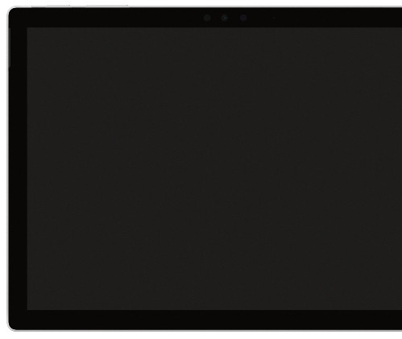
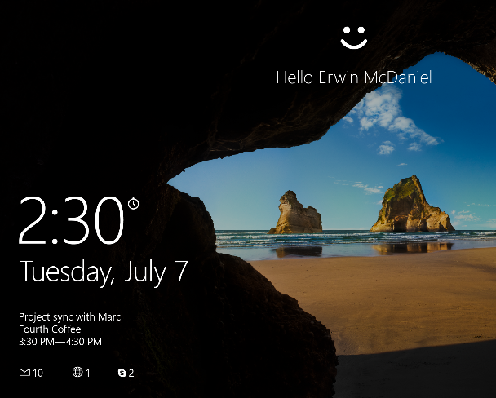

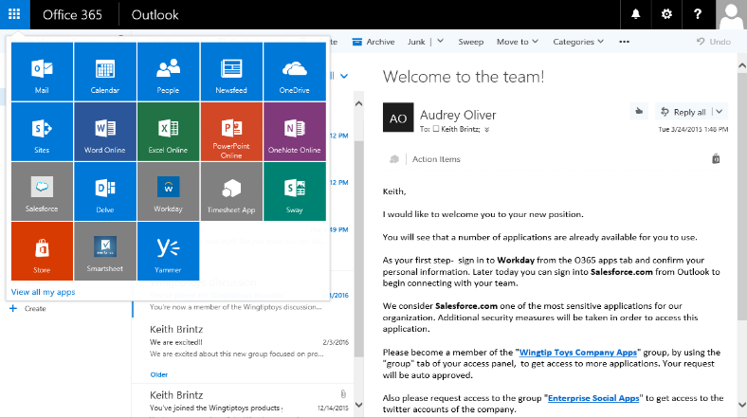
Simplify access to devices and apps
Additional Detail
Passwordless strong authentication via multiple factors
Single sign-on to thousands of apps
Self-service password reset
Notes:
With the combination of Windows 10 and Azure Active Directory in Microsoft 365, you can realize these benefits
Windows Hello enables strong authentication without passwords via multiple factors – bio metrics etc.
Sadly, passwords will not disappear over time and we understand your users may use different devices to access network. This is why our goal is to make sure we simplify access even with passwords for your users.
Users can access my apps portal to access their applications. This apps portal is also integrated to office 365 experience. We’re getting the benefit of the platform here.
From this portal, users can manage their accounts, their apps, groups, they can also do self service password reset which helps your help desk costs. Users can also do requests access to apps they currently have access to.
EMS Overview
© 2014 Microsoft Corporation. All rights reserved. Microsoft, Windows, Surface and other product names are or may be registered trademarks and/or trademarks in the U.S. and/or other countries. The information herein is for informational purposes only and represents the current view of Microsoft Corporation as of the date of this presentation. Because Microsoft must respond to changing market conditions, it should not be interpreted to be a commitment on the part of Microsoft, and Microsoft cannot guarantee the accuracy of any information provided after the date of this presentation. MICROSOFT MAKES NO WARRANTIES, EXPRESS, IMPLIED OR STATUTORY, AS TO THE INFORMATION IN THIS PRESENTATION.
12/11/2018
22

Slide 23

Additional Detail
Demo
Windows Hello
Notes:
Login with Windows Hello
Go to MyApps portal
Single sign-on to thousands of apps

Slide 24
Safeguard your credentials
Additional Detail
TPM
Global Admin
Strong authentication via multiple factors
Hardware protection for credentials
Secure biometrics
Privileged identity management
Uses multiple factors for authentication
Asymmetrical keys
Hardware generated credential
Credential isolated and protected by hardware
Hardened biometric implementation in Windows and hardware
Anti-spoofing and brute-force protection
Discover, restrict, and monitor privileged identities
Enforce on-demand, just-in- time administrative access when needed
Notes:
Talk Track
So, passwords no matter how long, complex, or frequently changed they are aren’t up to the task. The reality is that passwords are not secure and they never can be.
The solution to this problem is a strong authentication solution via multiple factors but most of the today’s solutions, even ones considered the state of the art like smartcards, are too difficult to use.
The smartcard, for instance requires complex infrastructure, card readers, etc and for that reason they just aren’t a viable solution for today mobile workforce and devices
In our own operating system, with Windows Hello, we addressed these challenges by taking the best parts of the smartcard and remove all of the friction and hardware requirements
You get a two-factor solution that can use a PIN or Biometrics option like your fingerprint or face for the first factor and then your PC will become the second.
With biometrics, you get a secure and more convenient experience that is available in over 100 types of Windows devices. PIN of course can be used everywhere.
For organizations under strict regulation, like FIPS 140-2, you can use a Windows Hello companion devices to remotely sign you into your PC and services. More on that in a few moments.
Because of this Windows Hello can work on any device that supports Windows 10 there are no challenging hardware requirements to accommodate. It works everywhere.
EMS Overview
© 2014 Microsoft Corporation. All rights reserved. Microsoft, Windows, Surface and other product names are or may be registered trademarks and/or trademarks in the U.S. and/or other countries. The information herein is for informational purposes only and represents the current view of Microsoft Corporation as of the date of this presentation. Because Microsoft must respond to changing market conditions, it should not be interpreted to be a commitment on the part of Microsoft, and Microsoft cannot guarantee the accuracy of any information provided after the date of this presentation. MICROSOFT MAKES NO WARRANTIES, EXPRESS, IMPLIED OR STATUTORY, AS TO THE INFORMATION IN THIS PRESENTATION.
12/11/2018
24

Slide 25
Identity & access management
Information protection
Built in security
Platform
Threat protection
Security management
Notes:
So now, let's talk about the second piece of our platform story, and that's around information protection.
Attacks are trying to get access to information/data

Slide 26

Do you have a strategy for protecting and managing sensitive information?
Do you know where your sensitive data resides?
Do you have control of your data as it travels inside and outside of your organization?
Are you using multiple solutions to classify, label, and protect sensitive data?
Notes:
Remember, this is about protecting information wherever it goes. And so, the question for our customers is, do you have a strategy for protecting and managing sensitive information? Do you know where your sensitive data resides? This seems like a very simple question, but trust me it is a complex issue for most organizations of any size. Trying to understand: “where is all of our sensitive information?” can be a huge project of its own.
The second question is, do you have control of your data as it travels both inside and outside of your organization? When it gets shared with customers and partners via email or SharePoint sites or other online services, when it goes out on someone's mobile device?
And lastly, are you using multiple solutions to classify, label, and protect sensitive data? We find that many of our customers are, and that it's a disjointed set of solutions that don't work together for a common solution.

Slide 27
Information protection Comprehensive protection of sensitive data throughout the lifecycle—across devices, apps, cloud services, and on-premises
Detect & classify sensitive information
Apply protection based on policy
Monitor & remediate
Across
Devices
Apps
Cloud services
On-premises
Notes:
So, our approach at Microsoft is to detect and classify sensitive information. This is really about understanding where is that sensitive information and what of it is sensitive?
Is it all sensitive? Is there just a portion of it? This is really applying those ideas of something that's confidential, highly classified and confidential, not so classified, public information, etc.
That can be a subject of intense debate inside of any large organization, involving the legal team and the risk management team and the IT organization and the business organizations.
The second piece is applying intelligent protection based on that policy. Knowing that the information is sensitive, what type of information protection am I going to apply to it? What is the policy that governs that?
And then lastly, monitoring and remediating. So, understanding where is information going? Who's accessing it? How much control do we actually have over it? And then remediating, understanding how we can make it better in the next cycle. And we want to make sure that we do this across a pretty broad surface area, from devices to applications, to cloud services and to on-premises systems. Across all of those surfaces we really need to make sure that we're understanding how we apply that protection policy.
EMS Overview
© 2014 Microsoft Corporation. All rights reserved. Microsoft, Windows, Surface and other product names are or may be registered trademarks and/or trademarks in the U.S. and/or other countries. The information herein is for informational purposes only and represents the current view of Microsoft Corporation as of the date of this presentation. Because Microsoft must respond to changing market conditions, it should not be interpreted to be a commitment on the part of Microsoft, and Microsoft cannot guarantee the accuracy of any information provided after the date of this presentation. MICROSOFT MAKES NO WARRANTIES, EXPRESS, IMPLIED OR STATUTORY, AS TO THE INFORMATION IN THIS PRESENTATION.
12/11/2018
27

Slide 28


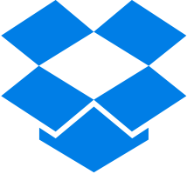


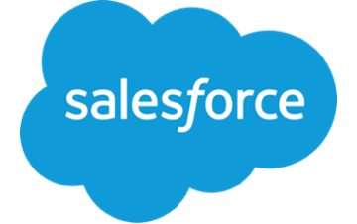

Follow the data—throughout its lifecycle
Additional Detail
Data gets detected
Data gets monitored
Data gets protected based on policy
Data gets created, imported, & modified across various locations
Sensitive data gets classified & labeled
Data travels across various locations, shared
Data gets retired, deleted
Do you need the flexibility to apply a range of protection actions, based on how sensitive the data is?
Does protection need to persist with the data, even as it travels across devices, SaaS apps and on-premises file shares?
Do you have the protection options you need in order to comply with internal policies and external regulatory requirements?
Are you able to empower end-users to protect content themselves, or apply automatically based on company policies?
Do you have the right notifications and education for end-users to ensure they are being responsible with sensitive data?
Have you defined what “sensitive data” means for your company?
Do you have a way to detect sensitive data across your company?
Do you have a way to ensure that labels persist with the data—wherever it travels?
Which regulations and compliance factors impact you?
Are you able to empower end-users to classify and label content themselves, or apply automatically based on company policies?
Apply protection based on policy
Do you have visibility into how sensitive data is being access and shared, even across 3rd-party SaaS apps and cloud services?
Are you able to remediate actions immediately, such as quarantine data or block access?
Are you able to integrate event information into your SIEM system or other tools?
Monitor & remediate
Detect & classify sensitive information
Notes:
After data is created or originated, you typically want to have a system in place to scan and detect sensitive data as it moves across devices, apps and services. In most environments, only a small percentage of the entire corpus of data contains sensitive information. The key is to be able to identify and detect the data that contains the sensitive or important information you care about.
Once sensitive data is detected and identified, you want to be able to classify and label that data in a manner that reflects its sensitivity. Even if the data is considered sensitive, they are typically different levels of sensitivity, and you may want different actions to be applied based on the level of sensitivity. For example, if a document contains employee ID numbers it may be labeled as Confidential, whereas if it contained Social Security Numbers, it may be labelled as Highly Confidential.
Once the data has been stamped with a sensitivity label, your company should be able to apply the appropriate protection policy automatically applied. This may include one of several protective actions, such as encryption, restricting access rights, applying visual markings or a watermark, applying a retention or deletion policy, OR even a data loss prevention action such as blocking sharing.
Whether the data stays in one place or moves around, it’s critical that IT has the ability to monitor data access and sharing, usage and respond quickly to potential abuse or threats. This can be in the form of real time alerts, emails or reporting dashboard.
Finally, depending on the sensitivity of data and corporate defined policy, as the data ages it is subject to expiration, retention and deletion. This is an important aspect of overall information protection, because if sensitive data persists in the environment longer than necessary, it can pose a potential risk if discovered and compromised.
As you can see, there are key considerations to evaluate at each step of the lifecycle.

Slide 29

Why Microsoft?
Additional Detail
Protect sensitive data wherever it lives or travels
Get started easily with built-in policy templates, then expand, enhance, and customize
Apply flexible protection options, including encryption, blocking access, applying visual markings
Enforce security policies while also enabling end-user productivity
Notes:
It’s easy to get started and easy to incrementally add additional capabilities over time as your information protection strategy evolves and matures. Our solutions help you:
Protect sensitive data wherever it lives, travels or is shared
Customize your policies and apply a range of protection options, including encryption, blocking access, applying visual markings – you are in control
Enforce your security policies while also enabling end-user productivity by providing education and notifications to end-users to help them work in a responsible manner
We will continue to invest in enhancing our protection capabilities as well as strengthening the integration across our technologies.

Slide 30
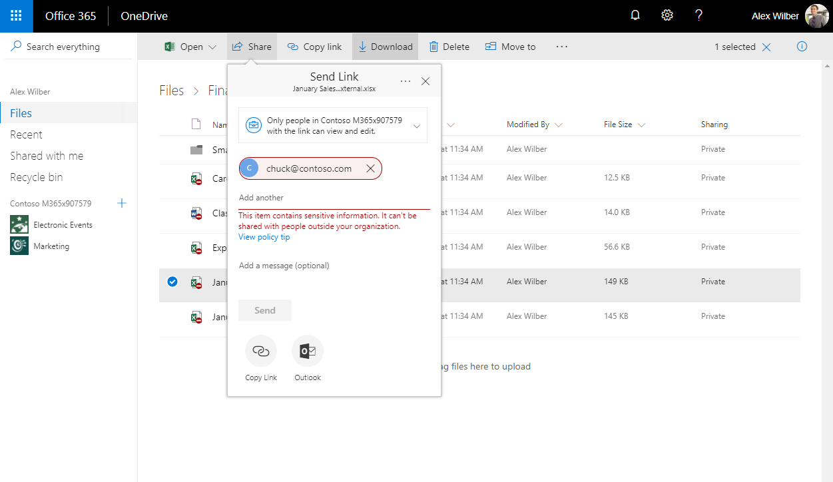
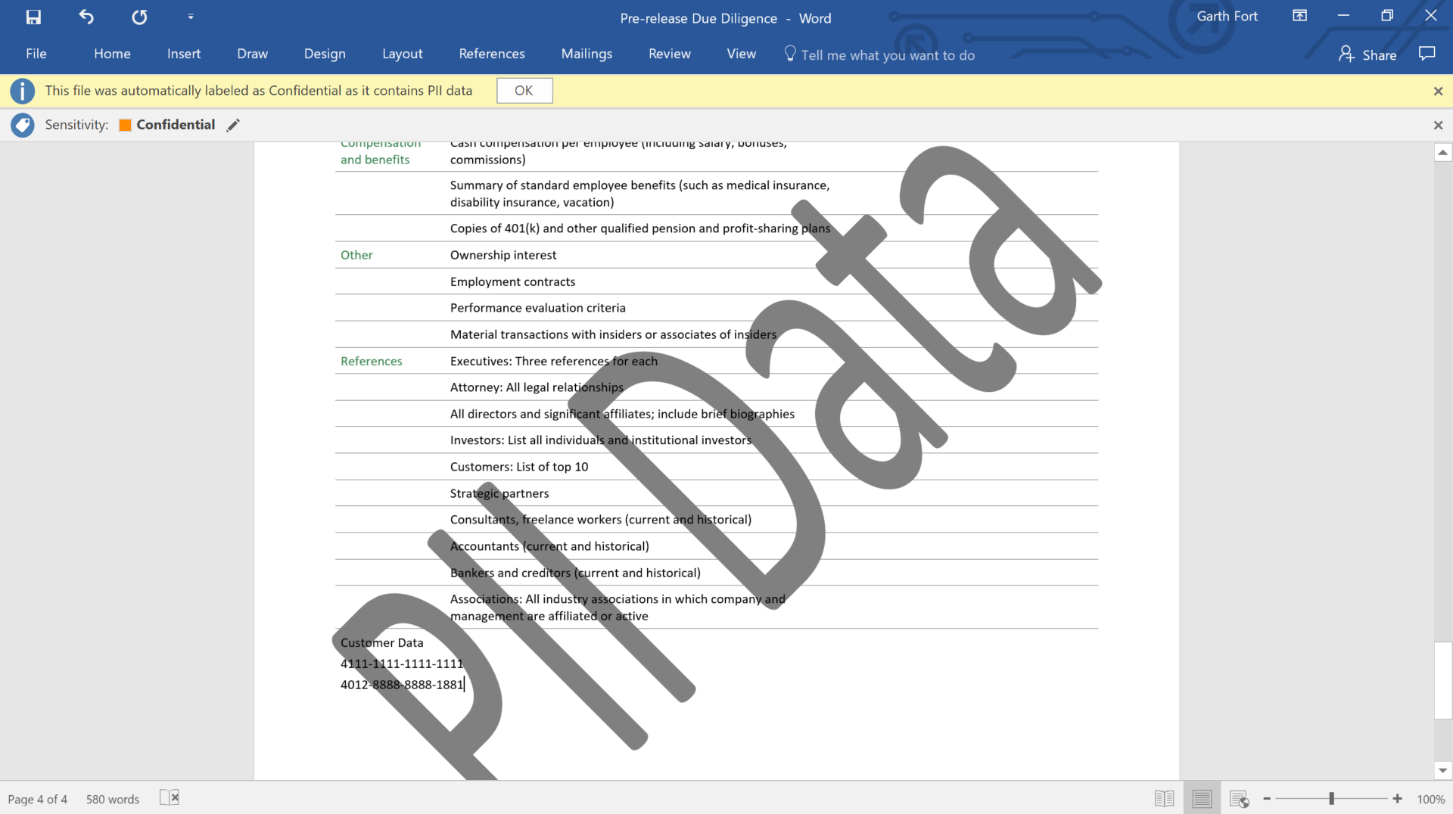
Additional Detail
Demo
Information protection
Notes:
Placeholder for demo video

Slide 31
Protect data in cloud apps
Additional Detail
Uploaded to public share
Identifies document tagged INTERNAL being shared publicly
!
User
Cloud App Security Portal
Move to quarantine
!
INTERNAL Azure information protection
Restricted to owner
Role: Finance
Group: Contoso Finance
Office: London, UK
Admin notified about problem
Notes:
In this example, sensitive data is protected even as it is uploaded to a cloud app
This has become a very common scenario, as workers store and share data across potentially several cloud storage services and SaaS apps.
When a user creates a document that contains sensitive data, such as credit card information or confidential project information, Azure Information Project labels the document as “INTERNAL”, which means it shouldn’t be shared with others.
If the user then tries to upload this document to a cloud storage location, such as using Box, this is detected by Microsoft Cloud App Security
MCAS will understand the INTERNAL label and enforce policy to move the file to quarantine and then restrict access to only the file owner

Slide 32
Prevent data loss in Office 365
Additional Detail
Attaches to email
Uploads to SharePoint or OneDrive for Business
CLASSIFIES content as sensitive based on DLP policies
SHAREPOINT ONLINE
ONEDRIVE FOR BUSINESS
!
User
Security & Compliance Center
!
!
Role: HR, works with employee data
SENSITIVE DATA Office 365 DLP policy
Alert sent to admin and end-user
Policy tips
block sharing
Restricted
to owner
Notes:
Many customers use Office 365 as their main productivity service, and our data loss prevention capabilities help prevent accidental sharing of sensitive data
In this example, a worker in HR often works with documents that contain employee information.
You can configure the DLP policy to detect personal data, such as Social Security Numbers, credit card numbers or even employee ID numbers
If content containing this type of information is sent over email or uploaded to SharePoint Online or OneDrive for Business, the DLP policy will get enforced
End users can be notified within the app that they are working with sensitive data, and sharing and sending of the content can be blocked

Slide 33

Protect sensitive data on unmanaged devices
Additional Detail
Intune configures app protection policy
Copy/Paste/Save As controls
PIN required
Encrypt storage
User
User adds business account to OneDrive app
User is prompted to create a PIN
User edits document stored in OneDrive for Business
User saves document to…
Allow access
OneDrive for Business
Notes:
In this example, sensitive data on an unmanaged devices is protected through the use of Intune app protection policies
Suppose you’re on an Android mobile phone and then you install the OneDrive for Business app
Intune policies can be configured to prevent the copying and pasting of data within the app
Policies can also restrict the saving the document to only OneDrive for Business

Slide 34
Identity & access management
Information protection
Built in security
Platform
Threat protection
Security management
Notes:
Now, let's talk about threat protection. This is in some ways the classical idea that many people have when they think about cybersecurity issues. The interesting thing about threat protection is that it's really a means to an end. You want to make sure that you're protected against threats because they are the way that hackers and other attackers are trying to get access to your information.

Slide 35

How do you protect your organization from advanced threats?
How quickly can you detect suspicious activities on your network?
How do you know if credentials have been compromised?
How quickly can you remediate advanced threats?
How do you protect your users from email threats?
Notes:
So, the question in this area is, how do you protect your organization from advanced threats? The state of the art today is that all threats are fairly advanced. So, how quickly can you detect suspicious activities on your network or devices? Is the first question here. This is about understanding that at some point you will be breached. It's not always about deflecting attackers or preventing attacks. Those are important things too, but no single solution can ever be 100% effective, so it's also about understanding that at some point your defenses will be breached, and you need to be able to detect suspicious activities quickly so that you can quickly remediate that issue.
The second question is, how do you know if credentials have been compromised? We ask this because it's one of the main vectors of attack these days. What attackers are looking for is a set of known good user credentials that they can use then to access other systems on the network or traverse the network in some way to get to something sensitive.
Third, how quickly can you remediate advanced threats is a really important discussion to have with customers. Remember I said earlier that 96% of malware is now automated polymorphic. Meaning that attackers are tremendously automated, and so how quickly can you catch up with that automated threat? How quickly can you move as the threat moves quickly?
And lastly, how do you protect your users from email threats? Because this probably the primary vector for attack these days, either an attachment to an email or a malicious link or a phishing attack. Many of the biggest attacks that we see these days start from an email message.

Slide 36
Threat protection Built in, cloud driven, automatic protection
Reduce attack surface
Detect attacks faster and block them
Respond automatically to breaches where appropriate
Notes:
So, our approach to threat protection is to reduce the attack surface first. We want to make sure that we are preventing attack wherever possible, and that means making sure that the attack surface, as we call it, is as small as possible. We want to reduce the number of places where an attacker might find some kind of purchase into the system or the network or the endpoint device. This means filtering out malicious code or links before they ever reach a user – via email or other document sharing services; and also deep protection on endpoints that includes advanced hardware based security to isolate critical assets from attack.
The second part is, we want to detect attacks faster and block them. It can't all be about prevention. That's important, but it also has to be about understanding that you will be breached at some point, and how quickly can you know that you've been breached, so and then respond automatically. Unique to Microsoft is our ability to detect memory and kernel based attacks on endpoints.
That's point number three here, responding automatically to breaches where appropriate. There is a lot of sensitivity in IT security organizations around the idea of automatic remediation, but we do think it's very important to explore that area because we know that so many of the attackers are automated now.
Our approach here, across protection, detection, and response is to build capabilities in, not bolt them on. Whether we’re talking about a cloud service like Office 365 or Azure, or the endpoint operating system – Windows – we are focused on providing built-in protection and detection and response. This is critical to quickly detecting attacks across the digital estate.

Slide 37
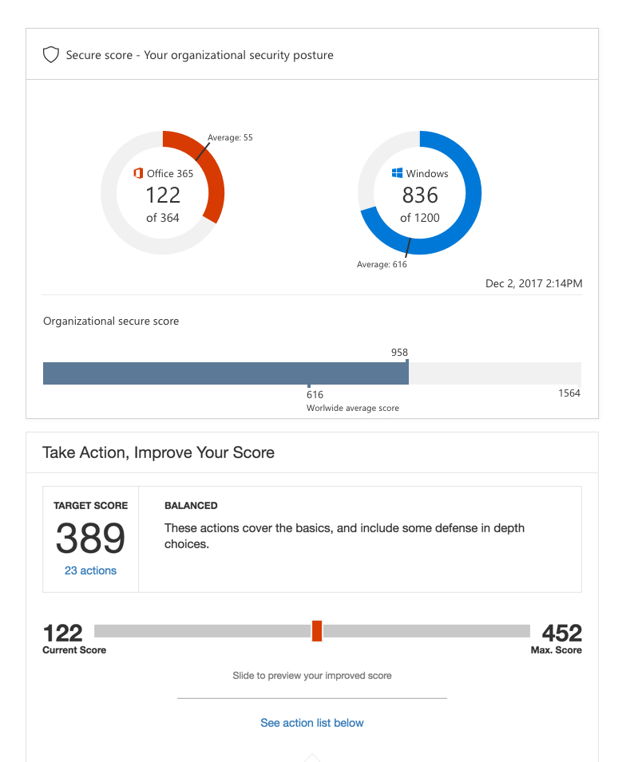
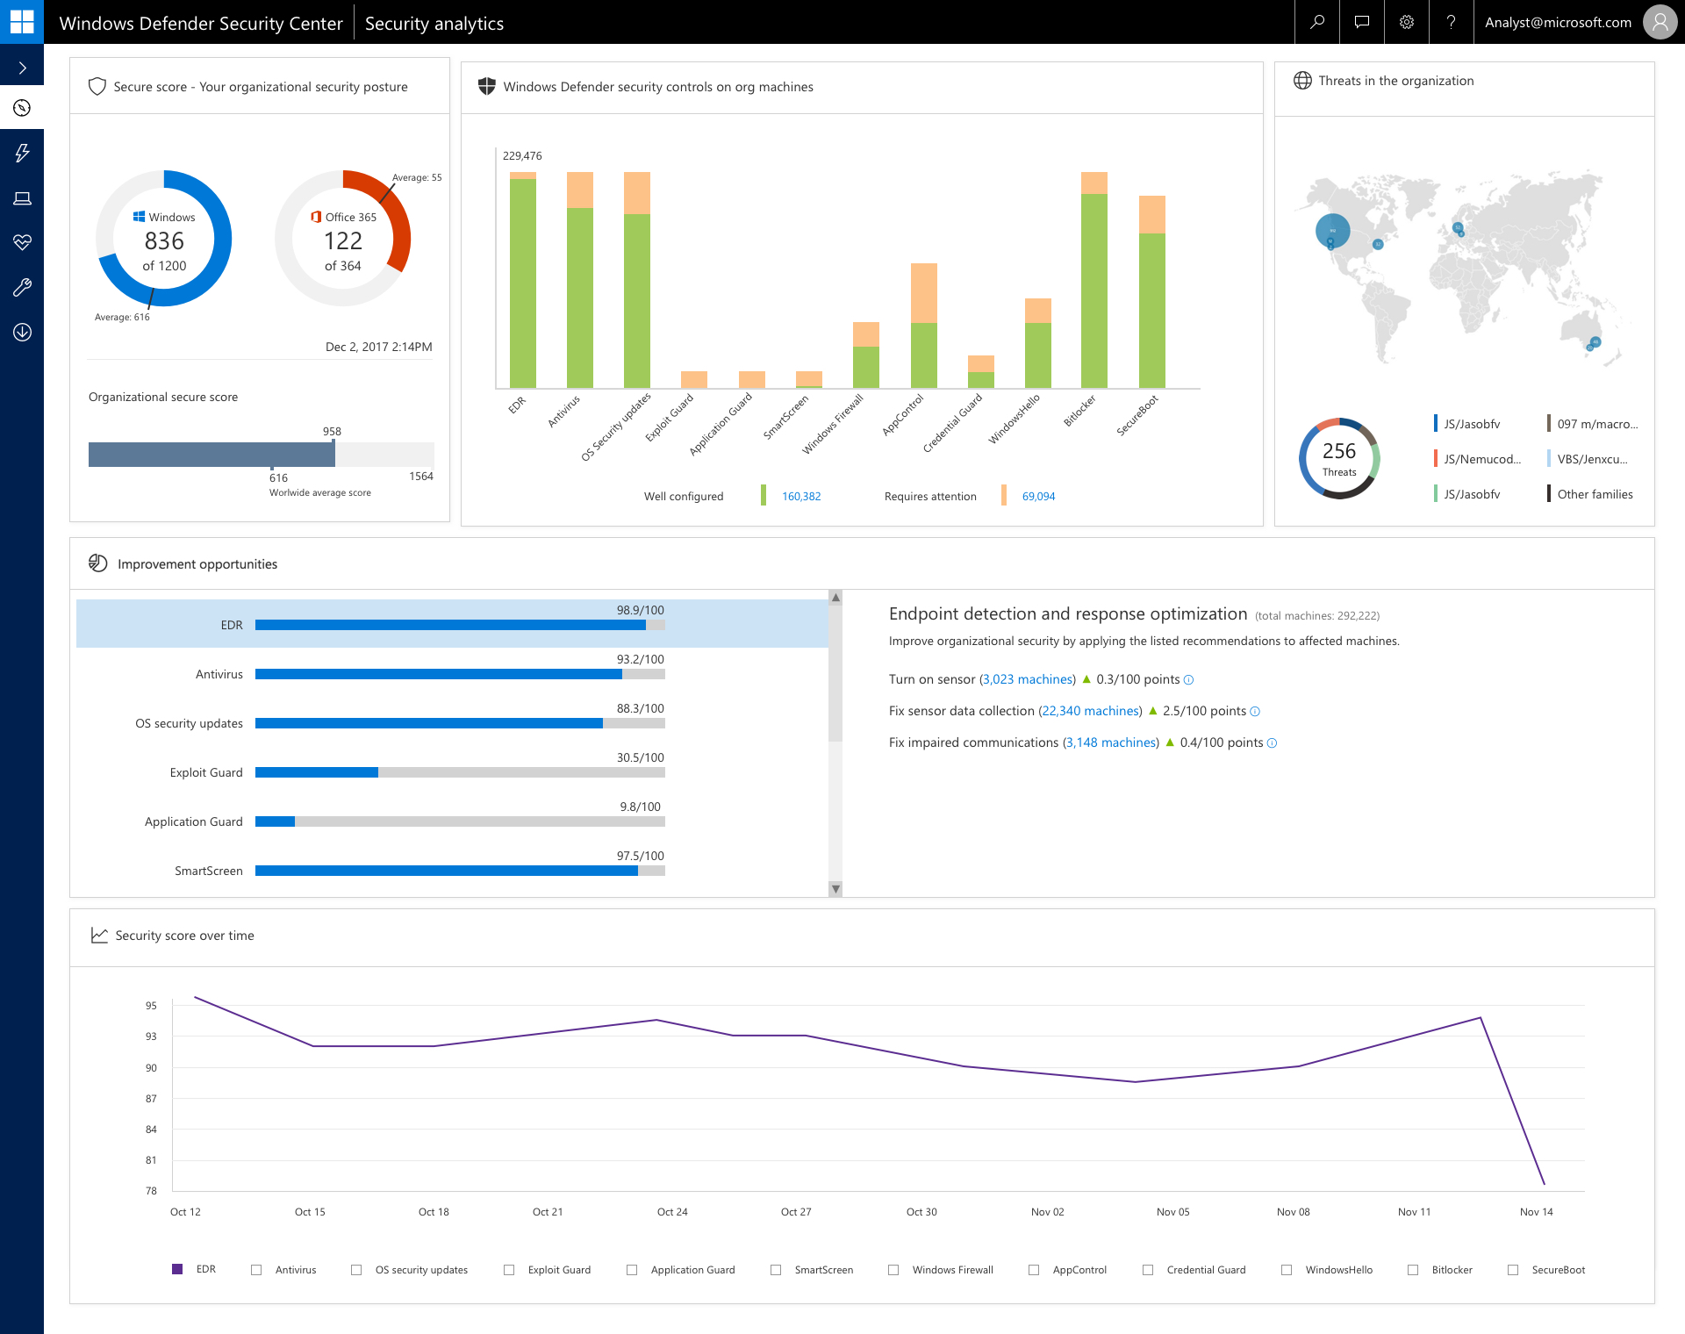
Reduce attack surface
Additional Detail
Assess your security state continuously
Enable security controls, and receive recommendation for further improvements
Remediate vulnerabilities and drive compliance
Notes:
Lets have a closer look at how we help your organization to reduce the attack surface:
Security controls to help protect from malicious threats are all deeply built into across devices, apps, information, and the network

Slide 38
Detect and block attacks
Additional Detail
Gain visibility and reduce blind spots
Detect attacks and zero-day exploits
Investigate your cloud ecosystem, the device, and your identities
Cloud-driven advanced behavioral analytics and machine learning
POWERED BY THE INTELLIGENT SECURITY GRAPH
Notes:
Few talking points about behavioral detections, ML – ISG
Unique sensors combined with the power of the Intelligent Security Graph (ISG) provide unparalleled detection capabilities

Slide 39
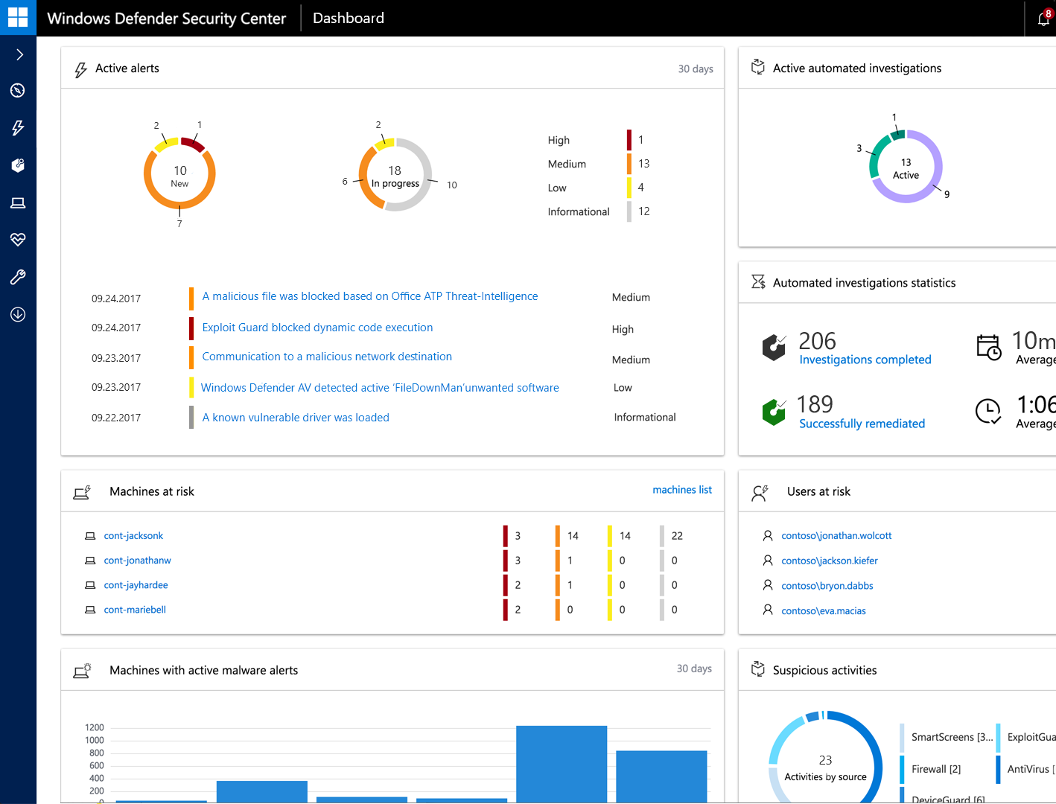
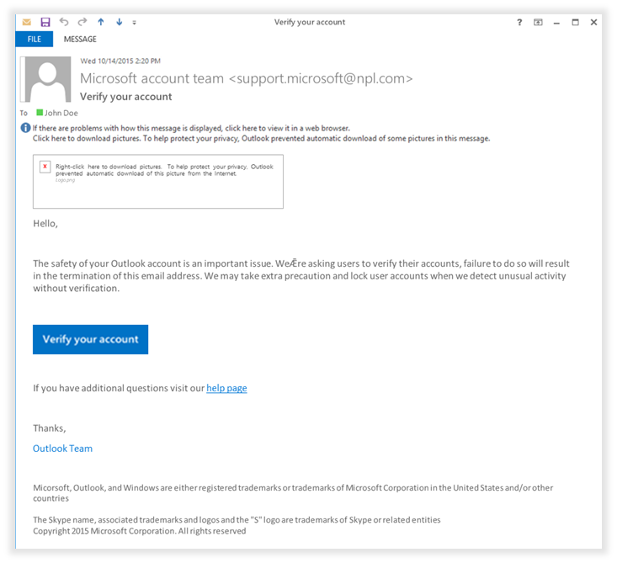
Demo
Detect and block attacks
Notes:
Placeholder for demo video

Slide 40
Respond automatically to breaches
Additional Detail
Investigate and remediate threats
Driven by artificial intelligence
Cyber analyst logic at scale
Choose how to close the loop
We do the investigation and remediation faster than anyone, and we do it at scale.
Applies industry best practices and intelligent decision-making algorithms to determine whether a threat is real and what action to take.
Automatically investigates alerts to determine the appropriate course of action. Multiple parallel investigations to resolve the full extent of a breach.
Remediates threats automatically without human intervention to stop further damage or infection. Your choice: fully automated or semi-automated.
Going from alert to remediation in minutes at scale
Notes:
Investigates and remediates cyber alerts/attacks for you
You don’t need to spend the time for investigations and remediation
Time and Scale
We could do the Investigation and Remediation faster than anyone and we could do it at scale
You have full control
We are providing you with the best swiss army knife money could buy, and you can control it

Slide 41
Respond automatically to breaches
Additional Detail
Attack comes in
Alert queue
Attack comes in
!
!
!
!
!
Attack comes in
!
!
!
Notes:
Lets have a closer look at automated investigation and response.
An attack comes in, and Office 365 ATP blocks it right at the front door.
The second attack compromises an identity and we block the next attack stage on the device.
In the third attack scenario the device got compromised, and the attacker tries to steal two identities, one was protected but he could compromise the other one and moves on to the server infrastructure.
We have detection coverage for various stages of an attack and because visibility is key, we also tell you about the activities we blocked.
With automation, the system now reaches out to all resources it has received alerts from – it first understands what needs to be done to remediate the entire threat and then performs the required actions, it also reaches out to the resources protected by other layers, ensuring that nothing else was missed.

Slide 42
Identity & access management
Information protection
Built in security
Platform
Threat protection
Security management
Notes:
The last category I want to cover in this platform area is security management. This is a tremendously important topic for our customers.
We spend $1 billion in R&D on security every year. Security is part of everything we build.
It has to be built-in
Not bold-on
Simplicity has made us more secure
We must be holistic

Slide 43

How do you manage security?
Do you know the security state of your full estate in real time?
How easily can you configure and manage the security posture across your estate?
How do you proactively improve your security practices over time?
Notes:
So, as we talk about this conversation, it’s really about, how do you know the security state of your full digital estate in real time?
Remember that broad set of technologies and endpoints and sensors that I talked about at the beginning of this presentation that our customers have to defend, even if they don't own or manage some of them. How do they know the security state of all of them is a pretty important topic, because it's how you detect when something has gone wrong.
The second one is how easily can you configure and manage the security posture across that estate? How many different tools do you have to access to get that configuration? How quickly can you get it done? You need to treat your security operations center personnel’s time as highly valuable because they are so difficult to hire and stretched so thin.
And lastly, how do you proactively improve your security practices? Over time, how are you getting better? This is something that we think is really important for us, and we think it's something that we can help our customers with tremendously.

Slide 44
Security management Provide visibility, control, and guidance, with shared intelligence across the digital estate
Visibility
Control
Guidance
Across
Devices
Apps & data
Infrastructure
Notes:
So, our approach here is really to provide visibility, that's the ability to see that security state across the entire digital estate.
Control, that's the ability to make those policy configurations easily, quickly and coherently most importantly, across all of the layers of the estate.
And then we can provide guidance that helps the security operations person know what to do next. “This alert arrived, I'm not sure what it means. What do I do next?” is a common question that responders have when it comes to defending the digital estate.
We have to do this across, again a pretty broad surface area, from devices to applications and the data that they touch, and the infrastructure itself.
EMS Overview
© 2014 Microsoft Corporation. All rights reserved. Microsoft, Windows, Surface and other product names are or may be registered trademarks and/or trademarks in the U.S. and/or other countries. The information herein is for informational purposes only and represents the current view of Microsoft Corporation as of the date of this presentation. Because Microsoft must respond to changing market conditions, it should not be interpreted to be a commitment on the part of Microsoft, and Microsoft cannot guarantee the accuracy of any information provided after the date of this presentation. MICROSOFT MAKES NO WARRANTIES, EXPRESS, IMPLIED OR STATUTORY, AS TO THE INFORMATION IN THIS PRESENTATION.
12/11/2018
44

Slide 45
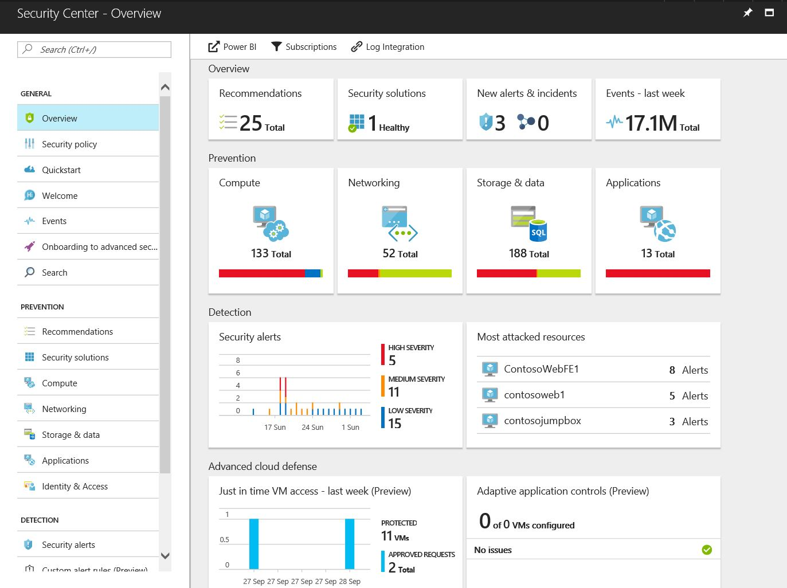
Demo
Security management

Slide 46

Consider a different approach
Reduce number of solution vendors
Use built-in protection—less to deploy and fewer agents to manage
Speed up response with tools that integrate detection and exploration across devices, identity, and information
Get the benefit of unparalleled visibility into threat landscape
Notes:
That was a lot of information. The way we like to bring this back together is to have our customers consider a different approach. Is there a way that they can reevaluate their IT security portfolio to reduce the number of solution vendors that they have to source products from? Is there a way that they can use built-in protection so that they have less do deploy and fewer agents to manage? Is there a way that they can speed up response by using tools that integrate detection and exploration across the full surface area that is important, devices, identity and information? And is there a way that they can benefit from the unparalleled visibility into the threat landscape that a vendor like Microsoft has?
And, of course, our answer here at Microsoft is, yes, there is a way to do that. And we think that we can help with all four of these points. We can help you reduce the number of solution vendors by providing you Microsoft 365, a package that provides all of these capabilities that we've just talked about in one package. We think that we can help you use built-in protection by building things into Windows and into Azure and into Office 365, so you don't have to deploy quite so many different solutions and manage all those agents. We think that we can help you speed up response by giving you tools that integrate across all of the different pieces of your digital estate, and that you can the benefit of our visibility into the threat landscape that comes as a part of the Intelligent Security Graph that powers all of these solutions that I've just talked about. They all dip into that Intelligent Security Graph and get smarter and better at protecting as a result of it.

Slide 47
The Microsoft solution
Identity & access management
Information protection
Threat
protection
Security management
Protect users’ identities & control access to valuable resources based on user risk level with conditional access
Protect documents and emails with encryption that travels with them as they move inside and outside your organization
Strengthen your pre-breach posture with built-in protection & recover quickly with automated remediation when attacked
Gain end-to-end visibility of your organization’s security and manage policy centrally
Azure Active Directory
Conditional Access
Windows Hello
Windows Credential Guard
Azure Information Protection
Office 365 Data Loss Prevention
Windows Information Protection
Microsoft Cloud App Security
Office 365 Cloud App Security
Microsoft Intune
Azure Advanced Threat Protection
Windows Defender Advanced Threat Protection
Office 365 Advanced Threat Protection
Office 365 Threat Intelligence
Azure Security Center
Office 365 Security Center
Windows Defender Security Center
Notes:
So, to bring it all together, here's where Microsoft has invested, across these four areas: identity and access management, information protection, threat protection, and security management.
We’ve put a tremendous amount of investment into these, and the way it shows up is across a pretty broad array of product areas and features.
Our Identity and Access Management tools enable you to take an identity-based approach to security, and establish truly conditional access policies
Our Information Protection solutions help you apply protection that travels with the information as it moves around—both inside and outside your organization
Our Threat Protection capabilities are built in to the platform, so you can strengthen both pre-breach protection with deep capabilities across e-mail, collaboration services, and end points including hardware based protection; and post-breach detection that includes memory and kernel based protection and response with automation.
And our Security Management tools give you the visibility and more importantly the guidance to manage policy centrally

Slide 48
Our unique approach
Intelligence
Platform
Partners

Slide 49
Partner with peers
Work with industry alliances
Partnership approach
Intelligence
Platform
Partners
Work with government
Notes:
Now let’s dig into the third area here, partners. And this is about not only how we partner with our peers in the industry, other providers of security tools, but also how we work with industry alliances and how we work with government and law enforcement agencies around the world.
This is a somewhat unique way that Microsoft thinks about partnership. It’s a little bit different from how other security vendors might be talking about partnership.

Slide 50
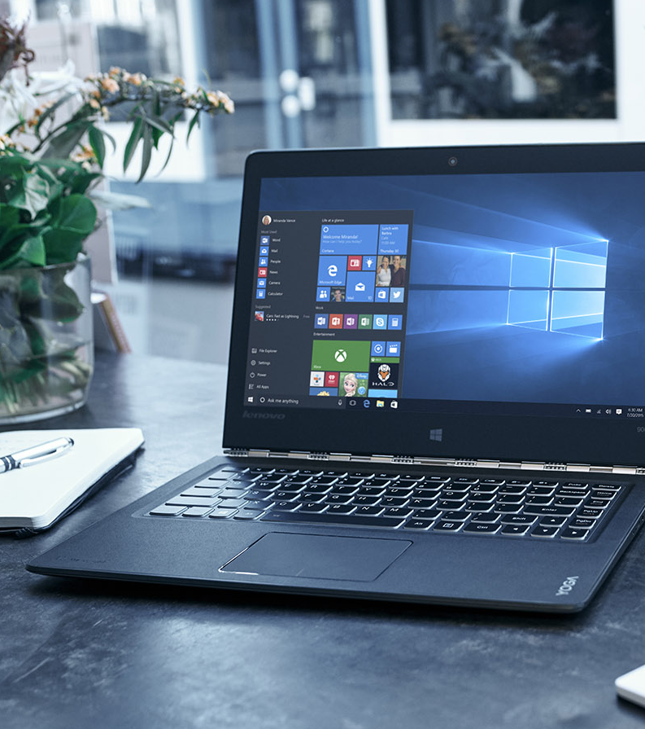
Device protection Microsoft + Intel® baking security deeper in the stack
Software layer
Rapid innovation and easily serviceable
Includes a broader surface area of attack
If defenses fail the entire operating system can be compromised
Firmware layer and hardware based isolation
Greatly reduced surface areas of attack
Integrity can more easily be monitored and validated
Resistant to attack even when operating system defenses fail
Silicon layer
Greatly reduced surface areas of attack
Physical hardware implementation makes tampering extremely difficult
Resistant to attack even when operating system defenses fail
Notes:
When we think about partnerships with our peers in the security industry, I want to focus on one that's a little bit unique and different from what other security vendors do. We bake security deeper into the hardware with our partners like Intel and, of course, into our first party Microsoft Surface devices.
When you think about this the important thing to remember is that the software layer where we all really interact with our PCs is a pretty vulnerable place. There's a lot of innovation that happens and there's a lot of easily serviceable components. But that means that it has a broader surface area of attack, and if the defenses here fail, the entire operating system could be compromised. So, we can't rely on just the software layer as the only place where we provide protection. We need to also use the firmware layer and some of the hardware-based isolation technologies that we've built into Windows 10 to greatly reduce the surface area, and then monitor and validate integrity a lot more easily. That makes it more resistant to attack even if the operating system defense has failed.
Deepest down, in the silicon layer, right into every chip, working with Intel and other hardware partners, we can reduce the attack surface even more. And then use hardware implementation to make tampering extremely difficult. And then, of course, keep that entire endpoint resistant to attack even when the operating system defenses have failed.

Slide 51

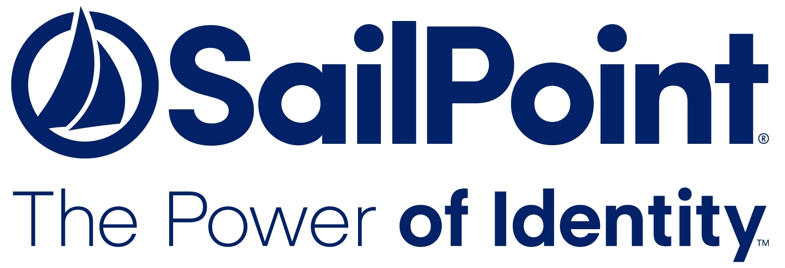
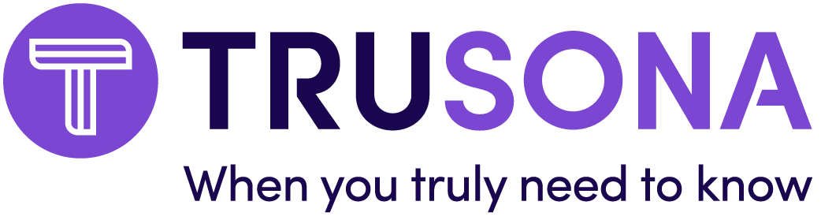


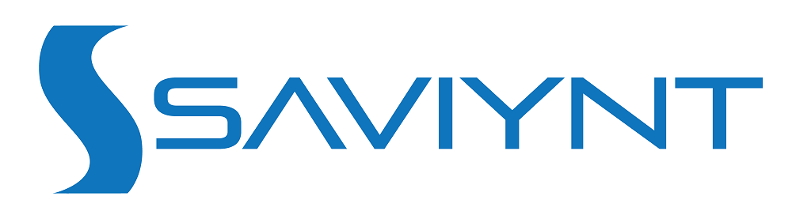
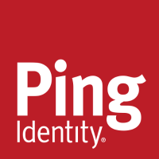
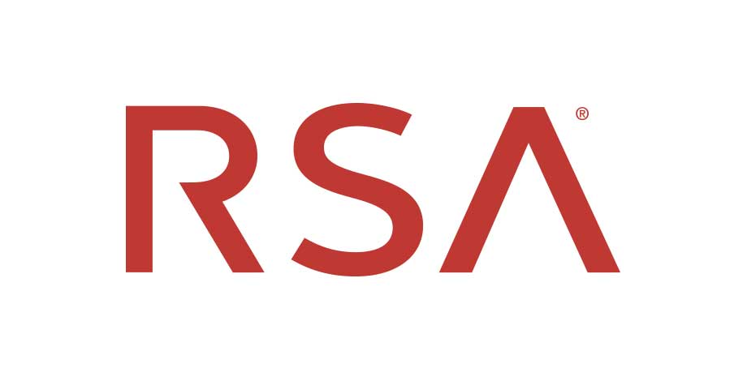



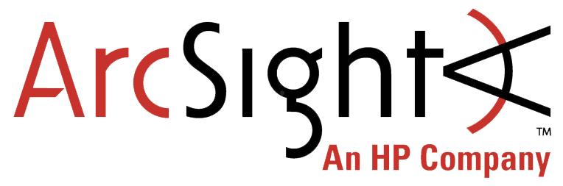


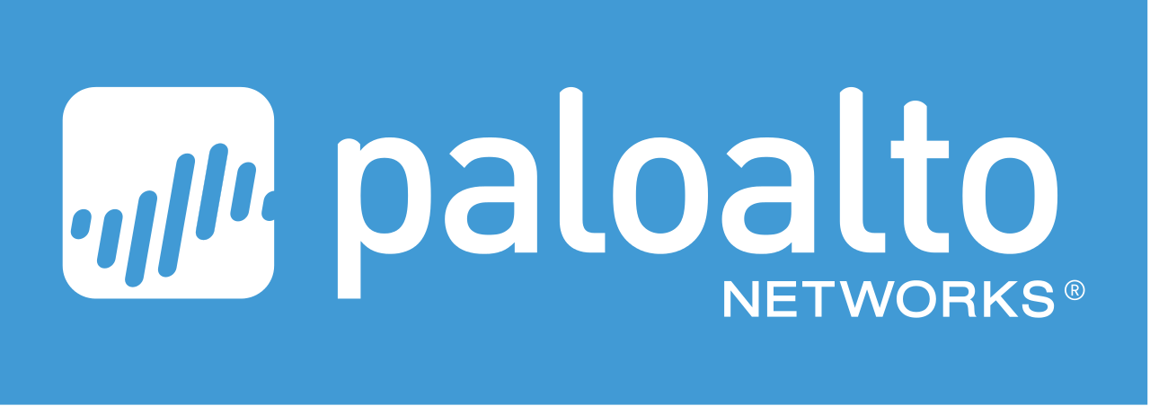
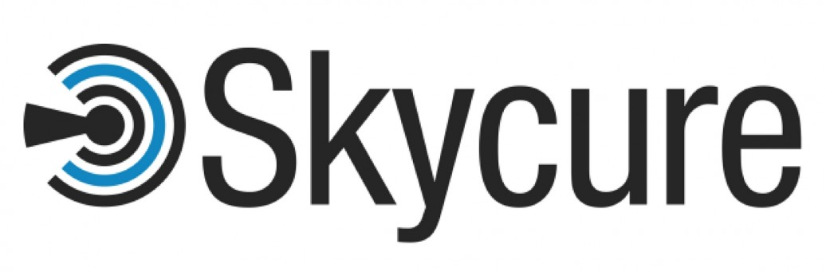
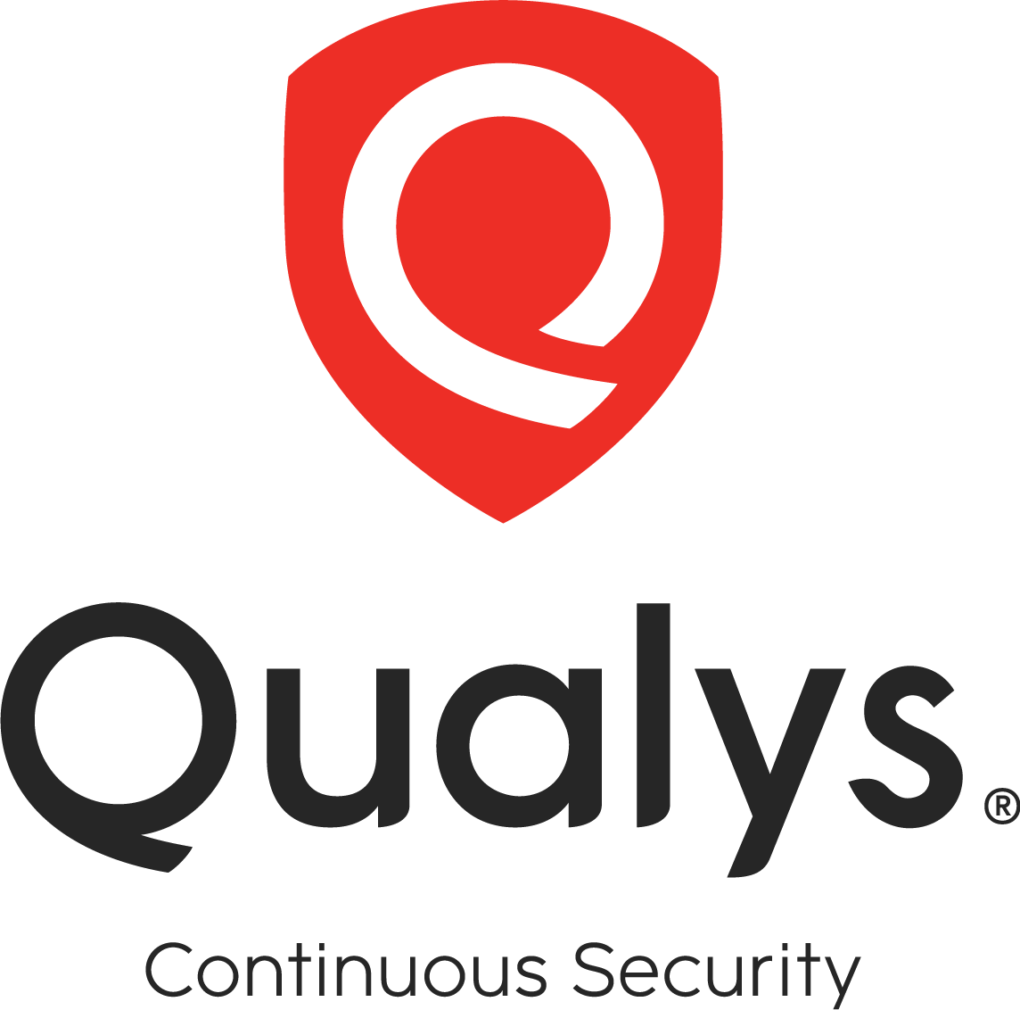


Integrating with your existing solution portfolio
Identity and access management
Information protection
Threat protection
Security management
Notes:
There are a number of other examples of ways that we partner with our peers in the industry. And this is because we understand that most of our customers are using dozens and dozens of security solutions today. The solutions we provide can add value and work with those existing solutions. You see here a few examples of the partnerships that we have across these four spaces.

Slide 52










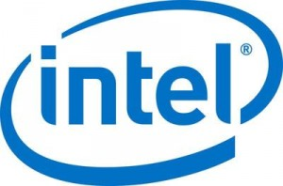


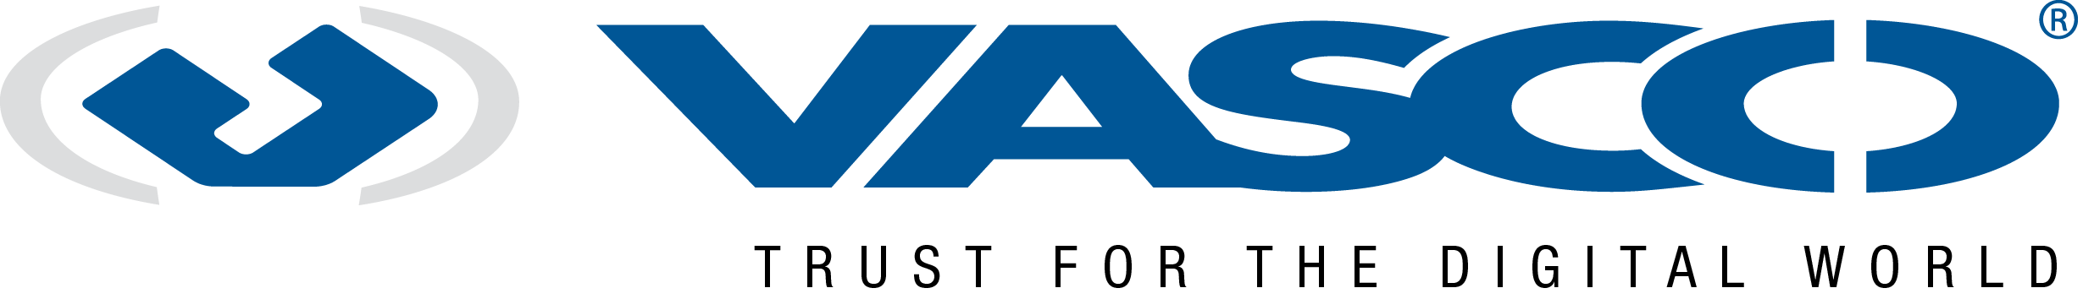

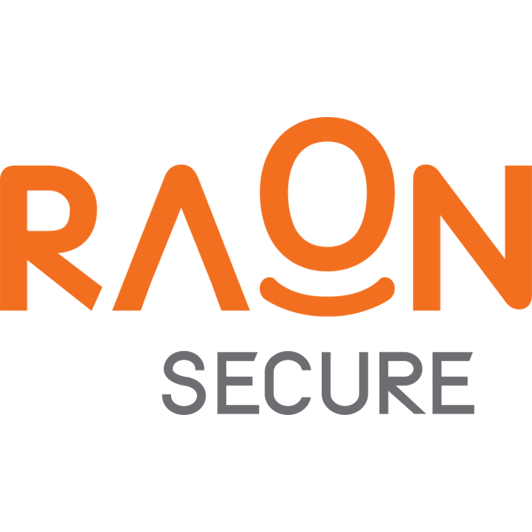
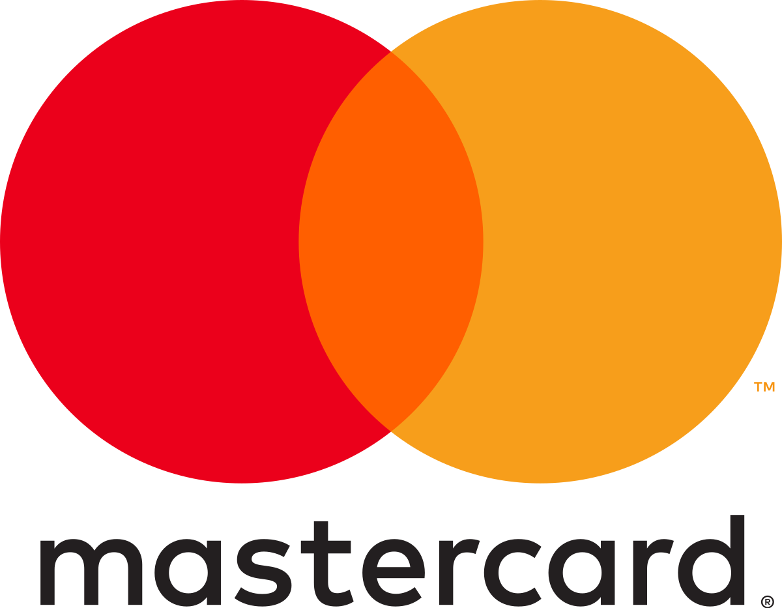
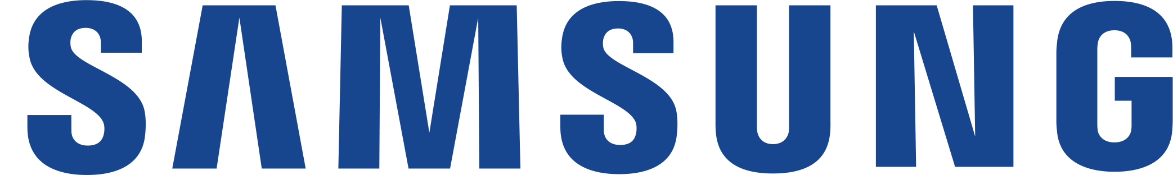





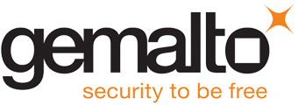



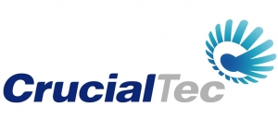




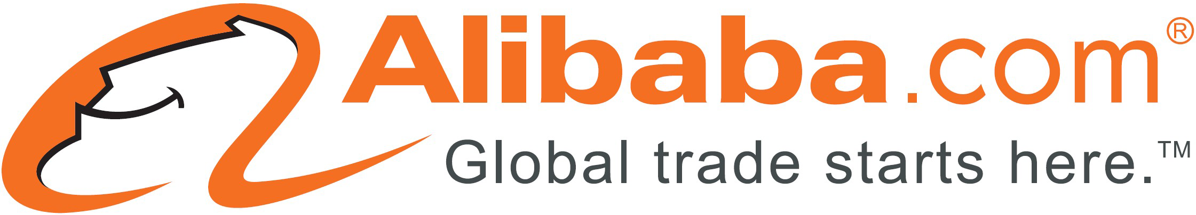
Fast identity online—the FIDO Alliance The world’s largest ecosystem for standards-based, interoperable authentication
Security on-premises and web
Secure mobile user credentials
Secure authentication
FIDO board members
Notes:
Now, let's talk about one example of the way that we work with industry alliances as part of our partnership strategy. The FIDO Alliance, or Fast IDentity Online, is one of the most important ones that we work with today. Because as I mentioned earlier, identity is probably one of the most important control points for security today. And so, what the Fast IDentity Online Alliance does is all of these board members work together to ensure that we can provide security on premises and in web properties for secure mobile user credentials and secure authentication.
And we really want to make sure that everybody who uses services day to day on the web or on-premises gets the same great experience I have as a Microsoft employee when I sign into my Surface with just my face and I don't have to use a password, but I still have secure authentication into every single service and application that I need to use throughout the day with that one secure sign-in.
This isn't about just facial recognition, but that’s an example of the type of great experience we can provide for all of the people who use these services and these websites, while maintaining secure authentication. We can all work toward a future of no more passwords.
EMS Overview
© 2014 Microsoft Corporation. All rights reserved. Microsoft, Windows, Surface and other product names are or may be registered trademarks and/or trademarks in the U.S. and/or other countries. The information herein is for informational purposes only and represents the current view of Microsoft Corporation as of the date of this presentation. Because Microsoft must respond to changing market conditions, it should not be interpreted to be a commitment on the part of Microsoft, and Microsoft cannot guarantee the accuracy of any information provided after the date of this presentation. MICROSOFT MAKES NO WARRANTIES, EXPRESS, IMPLIED OR STATUTORY, AS TO THE INFORMATION IN THIS PRESENTATION.
12/11/2018
52

Slide 53
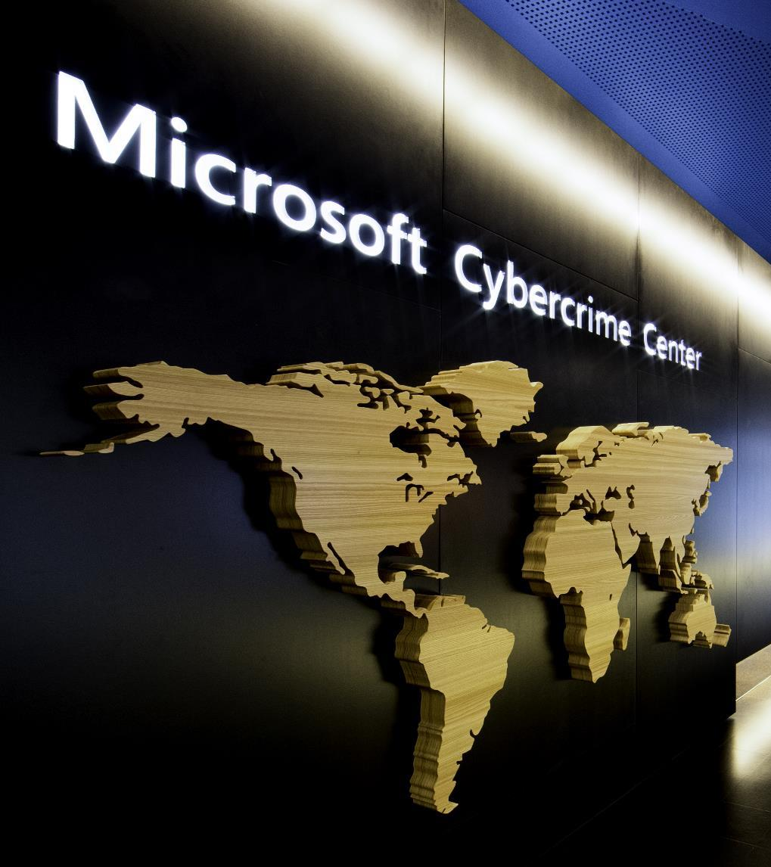
Digital Crimes Unit Leading the fight against cybercrime
Protecting people, organizations and our cloud through global disruptions and enforcement actions against cybercriminals
Investigations, forensics, and analytics
Machine learning, AI, and data visualization
Public and private partnerships
Creative legal strategies
Notes:
In the space of our partnership with governments and law enforcement agencies, I want to highlight the work that our digital crimes unit does. They are leading our fight against cyber crime here at Microsoft, protecting people and organizations through global disruptions, like take-downs of botnets, and enforcement actions where they help local law enforcement agencies capture and bring cyber criminals to justice. And so, this takes the form of investigations, machine learning, application, forensics, creative legal strategies, all sorts of tactics that our cyber crimes unit is able to employ here.

Slide 54

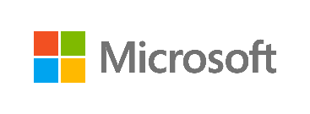
Microsoft Secure
Ensuring security to enable your digital transformation through a comprehensive platform, unique intelligence, and broad partnerships
Notes:
So, that wraps up the information I wanted to share today about Microsoft Security Solutions. Thank you for your time. Are there any areas that you’d like to explore in more depth?

Slide 55
Discussion and Questions

Slide 56
Microsoft 365 identity and access management solutions
Infrastructure
Identity
Apps & data
Devices
Azure Active Directory
Windows Hello
Credential Guard

Slide 57
Microsoft 365 information protection solutions Comprehensive protection of sensitive data across devices, cloud services, and on-premises environments
Devices
Office 365
Cloud services, SaaS apps and on-premises
PCs, tablets, mobile
Exchange Online, SharePoint Online, and OneDrive for Business
Highly regulated
Azure
SaaS and ISVs
Datacenters, file shares
Windows Information Protection
Office 365 Data Loss Prevention
Office 365 Advanced Data Governance
Office 365 Cloud App Security
Azure Information Protection
Microsoft Cloud App Security

Slide 58
Microsoft 365 threat protection solutions Comprehensive protection, detection, investigation and response across identity, apps and data, devices, and infrastructure
Infrastructure
Identity
Apps & data
Devices
Azure Advanced Threat Protection
Office 365 Advanced Threat Protection
Windows Defender Advanced Threat Protection
Azure Security Center
Exchange Online Protection
Azure Active Directory
Office 365 Threat Intelligence
Microsoft Cloud App Security

Slide 59
Enhanced security through simplified and intelligent security management with Microsoft
Devices
Apps & data
Infrastructure
Windows Defender Security Center
Office 365 Security & Compliance Center
Azure Security Center
Microsoft Cloud App Security
A core data set makes all solutions more effective
Powered by the Intelligent Security Graph

